Slide 1
Distributed Application
Group 7 – Sheldon Benard and Gustavo Polins Pedro

Slide 2
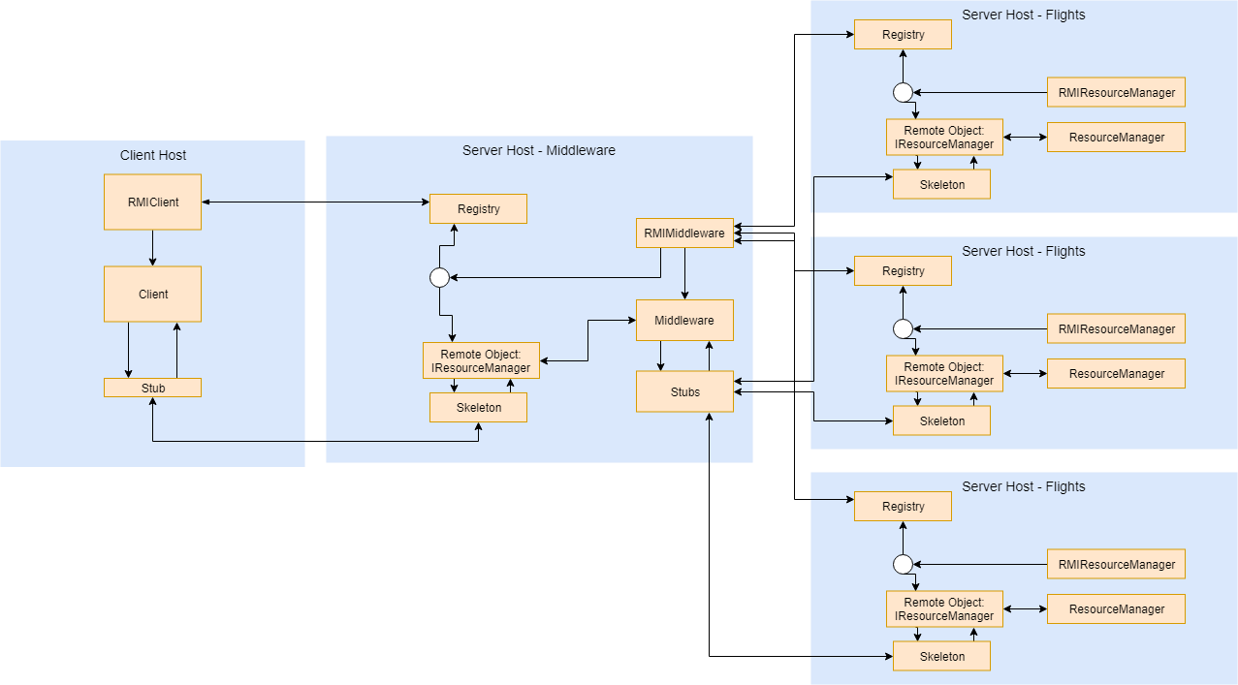
Remote Method Invocation
Client Host:
RMIClient locates middleware registry and does a lookup of remote object
Client provides a CLI, and it uses stub to call remote object methods
Resource Manager Servers:
RMIResourceManager registers IResourceManager object in the registry
ResourceManager implements the remote object interface and manages the data using a HashMap
Middleware Server:
RMIMiddleware registers IResourceManager object in the registry
Middleware implements the IResourceManager remote object and manages the Customer data type.
RMIMiddleware locates and looks up the Flights, Cars, and Rooms remote objects, and the stubs for these objects are available for Middleware. Requests involving the Flights, Cars, and Rooms data types will be forwarded to the appropriate server.

Slide 3
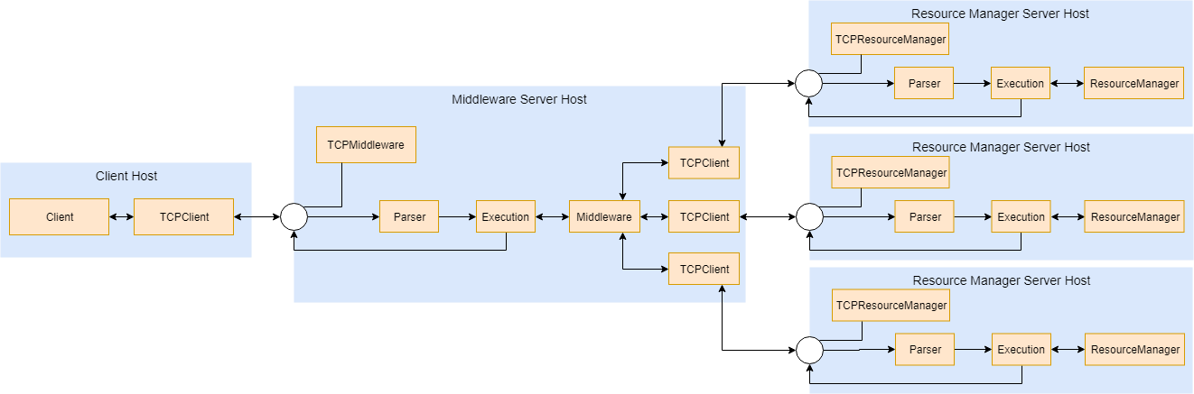
Transmission Control Protocol
Client Host:
TCPClient opens a client socket and connects to the Middleware server socket
Client provides a CLI, and it uses TCPClient > SendMessage(s) to message the Middleware
Resource Manager Servers:
TCPResourceManager sets up a server socket endpoint. Upon a new connection, a new thread is started to handle the message
Parser parses message, Execution executes the appropriate ResourceManager method and returns the result as a string
Middleware Server:
TCPMiddleware sets up a server socket endpoint for the Client host. Upon a new connection, a new thread handles the message
Parser parses message, Execution executes the appropriate Middleware method and returns the result as a string
Middleware has 3 TCPClients, each to message a different Resource Manager server socket. Requests involving the Flights, Cars, and Rooms data types will be forwarded to the appropriate server

Slide 4
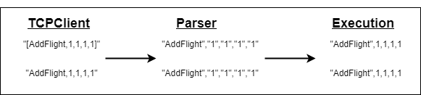
Our Implementation
Message Passing:
Concurrency:
Some of the concurrency concerns we had were:
The price of a flight changing while a customer is reserving an item,
A customer being deleted while reserving an item,
The availability of an item changing (via reservation, deletion) while a reservation is being filled,
A bundle being only partially filled due to a concurrent reservation
Thus, we implemented a strict paradigm, one in which any action that modifies the state of the data requires a synchronization on any connection objects (stub objects for RMI; TCPClient objects for TCP) that the action will use. If a customer is involved (ex. Reservation action), we also synchronize on the specific customer.
Functionality:
Customer data type is implemented on the middleware server host
New commands:
“Summary” takes in the xid (which is not used), and it outputs a summary of the client-resource allocation. For each client, the resources they have reserved will be printed
“Analytics” takes in the xid (not used) and an upper bound. Any resource with remaining quantities less than or equal to the upper bound will be printed

